Slide 1
Warehouse Vision Study
Dynamic Markets Demand Warehouse Agility
Presenter Name
Date
Notes:
Rajnish hands over to AJ.

Slide 2
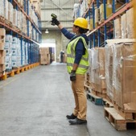
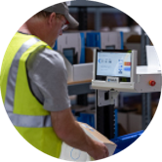
Zebra Warehouse Vision Study
Overview
E-Commerce Impact
Modernization
Perspectives
About the Study
Zebra Technologies commissioned a global research study among decision-makers and associates to analyze the latest trends and technologies transforming warehouse operations. The study includes over 1,500 respondents across organizations within manufacturing, retail, transportation, logistics and wholesale distribution. Azure Knowledge Corporation administered the online survey in January – February 2022.
Notes:
Zebra Technologies commissioned a global research study among decision-makers and associates to analyze the latest trends and technologies transforming warehouse operations. The study includes over 1,500 respondents across organizations within manufacturing, retail, transportation, logistics and wholesale distribution. Azure Knowledge Corporation administered the online survey in January – February 2022.
Today, we are going to look at some of the major trends that emerged from the study. I’ll break it down into four sections:
Overall warehousing trends as a result of recent global disruptions
The impact of increased e-commerce activity
Modernization today and tomorrow and the implementation trends and attitudes towards technology and automation
And finally, regional perspectives and wrapping up with some key takeaways
Let’s get started…

Slide 3
New Threats to Global Supply Chains
DECISION-MAKERS IN ALL SECTORS
85%
Add third-party logistics (3PL) services support within five years.
While the pandemic highlighted how quickly supply chain issues can impact the availability of goods, disruption can take place at any time due to natural disasters, geopolitical tensions, cyberattacks, labor strikes and more.
More complexity brings on more reliance and the need for collaboration amongst supply chain partners
Supply chain visibility more evident than ever
Warehousing decision-makers realize they need to do their part to support these efforts
DECISION-MAKERS IN RETAIL
77%
Report drop shipping volumes direct from manufacturers increased an average of 22% over the past two years.
DECISION-MAKERS IN ALL SECTORS
54%
Invest in increased visibility across the supply chain in the next 1-3 years.
Notes:
In this study, one of our objectives was to look at how a major disruption could impact an industry like warehousing. We know that disruption can take place at any time due to natural disasters, geopolitical tensions, cyberattacks, labor strikes, pandemics and more. With the global nature of the pandemic, it was a common experience amongst all our survey participants.
As supply chains become more complex, the more reliance there is amongst supply chain partners, the more collaboration and visibility is needed and the more each node of the supply needs to do their part to support the global effort.
A few examples of that illustrate this include:
Decision-makers plans to utilize third-part logistics services. At the rate operators need to get up to speed, use of these services that are equipped to execute specific operations will be the alternative for some operators.
Retailers show a greater dependence on their manufacturing partners to ship to customers.
Currently, about one-third of respondents are investing in increased visibility ACROSS the supply chain, however in the next 1-3 years more than half of the respondents said this is something they plan to do.

Slide 4
Operational Velocity Demands A New Way Forward
The sudden rise in e-commerce activity highlighted the outcome of several unaddressed individual challenges combining under pressure. These top six challenges plague warehouse decision-makers today:
DECISION-MAKERS’ TOP SIX CHALLENGES DUE TO INCREASED E-COMMERCE
1.
Faster delivery to end customers
2.
Increased transportation costs
3.
Inventory accuracy and visibility
4.
Shorter order lead times
5.
Unpredictable consumer demand
6.
Complexity of omnichannel logistics
Notes:
This disruption was the perfect storm of several challenges that were probably left unaddressed and when combined under pressure, the result likely opened the eyes of many operators.
Let’s see what they need to address…

Slide 5
Meeting Demands
Leaning more heavily on third-party logistics (3PL)
Front-line workers still very much in demand
With warehouse operations’ role in customer satisfaction, organizations recognize that they may not have the specialization or the technology to quickly ramp up their operations to meet the demands
Decision-makers realize they need people to meet new customer demands, despite the shrinking labor pool and availability of new automation solutions
Within 3 years
Within 3 years
74%of decision-makers
86%of decision-makers
Plan to add third-party logistics (3PL) services or operations to support increased e-commerce activity.
Plan to expand their workforce to support their increased focus on e-commerce.
Notes:
To help meet demands, decision-makers are turning to supply chain partners in the 3PL sector. Three-quarters of decision-makers say they’ll add third-party logistics (3PL) services or operations to support increased e-commerce activity within the next three years. In 2019, only 60% of respondents planned to implement this strategy to support their organization’s warehouse operations over a three-year period.
Decision-makers realize they need people to meet new customer demands. Despite the shrinking labor pool and availability of new automation solutions, 86% of decisions-makers plan to expand their workforce in the next three years to support their increased focus on e-commerce. In 2019, 73% of decision-makers expected to add headcount as part of their implementation plans.

Slide 6
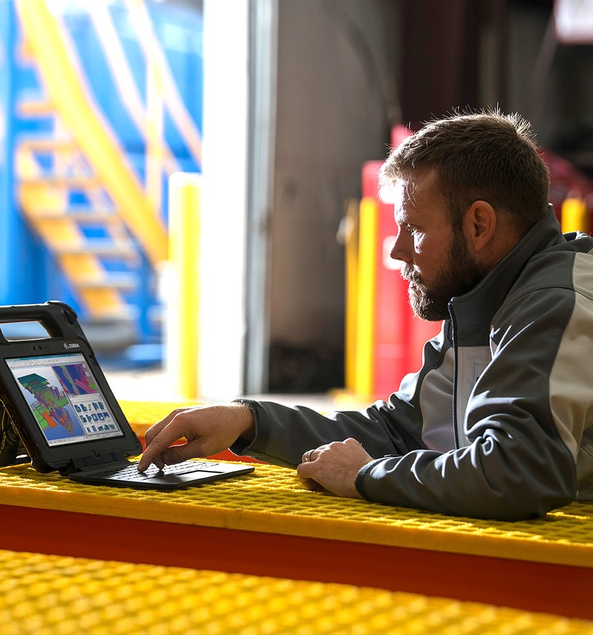
Addressing Labor Constraints
Workers play a key role in making warehousing operations more resilient, and labor challenges are a significant concern among decision-makers.
More than half of decision-makers Report finding and training workers among their biggest challenges for their organization
4.7 weeks Average Time to train workers to full productivity in warehouse operations
85% of decision-makers Plan to prioritize labor optimization within the next three years
Notes:
At the root of many of these challenges, labor is an area many admit needs addressing:
Fining labor is a challenge, but we know from our associate perspectives that technology is a competitive advantage.
Once, labor is retained, it is almost 5 weeks to get them to full productivity.
While labor is at a premium, they must make the most of the staff they have.

Slide 7
A Changing Workforce Has Raised Expectations
As a generation of digital natives enters the workforce, the importance of technology has increased, as well as competition for labor.
Many decision-makers face staffing challenges, but still must ensure productivity regardless of these challenges, therefore:
Associates have their expectations for the role technology will play in the warehouse environment:
83%
92%
83%
66%
Rank offsetting recruitment challenges as one of the top three drivers for implementing automation.
Expect business software and hardware devices to be as easy to use as their personal smartphones.
Agree that technology advancements will make the warehouse environment more attractive to workers.
Agree they would be more likely to work for an employer that gives associates modern devices versus one that provides older or no devices.
of decision-makers using or plan to automation within three years,
Notes:
Another objective for the survey was to look at the changes in labor and the expectations and decisions incumbent on warehouse decision-makers today. We’ve all followed the headlines around the challenges many regions throughout the world are having finding, training and retaining labor. For the first time, we’ve included the voice of the associate in our survey.
Associates have expectations around technology, that may help shed some light on how to be competitive during times of labor challenges.
In the face of labor challenges, decision-makers still need to keep operations running. Of those decision-makers currently using or planning to use automation within the short term ranked offsetting recruitment challenges among the top three drivers for implementing it.

Slide 8
Employers Recognized The Need To Keep Employees Satisfied
60%
57%
Front-line workers reflect on employers’ hiring and retention challenges the past two years and how it has impacted them
Improved working conditions
Used technology to make work easier
Of associates say positive workplace changes are happening amid labor shortages
45%
43%
82%
Increased wages, bonuses and perks
Provided technology to enable flexible work shifts
Notes:
The good news is, many employers recognized how important their labor was to them and made positive workplace changes. This finding actually surprised us. With headlines dominating the news about short-staffed warehouse and fulfillment centers, we thought the impact would be negative, but 82% of associates say they were impacted positively. In fact, when we dove deeper, while increased wages and bonuses were a factor, we found that non-monetary improvements were recognized by a higher percentage of respondents.
To pull this all together, let’s look at what decision-makers desired outcomes are to support their commitment to their associates… (click to go to next slide)

Slide 9
The Result: A Focus On Modernization
Decision-makers realize the need for resiliency, understand the implications of not making changes and are taking steps to modernize their operations.
DECISION-MAKERS FOCUS ON WAREHOUSE MODERNIZATION
80%
87%
61%
87%
Agree the pandemic prompted faster modernization
Plan to accelerate timelines of modernization projects within three years
Plan to implement real-time inventory tracking within a year
Agree new technology is needed to be competitive in the on-demand economy
Notes:
What did all of these disruptions prompt for warehouse decision-makers?
The pandemic indeed was a driver for faster modernization according to 80% of respondents.
87% plan to accelerate timelines of modernization projects.
Within a year, 61% plan to implement some form of real-time inventory tracking.
And almost 90% see that new technology is needed to be competitive in today’s on-demand economy.
Let’s look more closely at some of the drivers…

Slide 10
While technology investment carries some risk, 82% decision-makers say their organizations believe investing in automation far outweighs the risk of not implementing it.
Notes:
While technology investment carries some risk, 82% say their organizations believe investing in automation far outweighs the risk of not implementing it.

Slide 11
Getting Started
61%
Implementing Warehouse Automation
of decision-makers
Augmenting labor with software and devices first is the best way to introduce automation into warehouse operations
Uncertain where to start automating their warehouse operations
Decision-makers (+6 pp since 2019)
Associates
9 in 10
decision-makers
83%
89%
Will seek outside resources to help identify and execute warehouse optimization and automation solutions within five years
Notes:
Automating warehouse operations can be daunting, there are a lot of options. While a high percentage of decision-makers may be comfortable with integrating new technology into their warehouse ecosystems, 61% said they have some uncertainty about exactly where to start automating their warehouse operations. However, most agree augmenting labor with software and devices first is the best way to introduce automation, and within five years, nine in 10 decision-makers will seek outside resources to help identify and execute warehouse optimization and automation solutions.

Slide 12
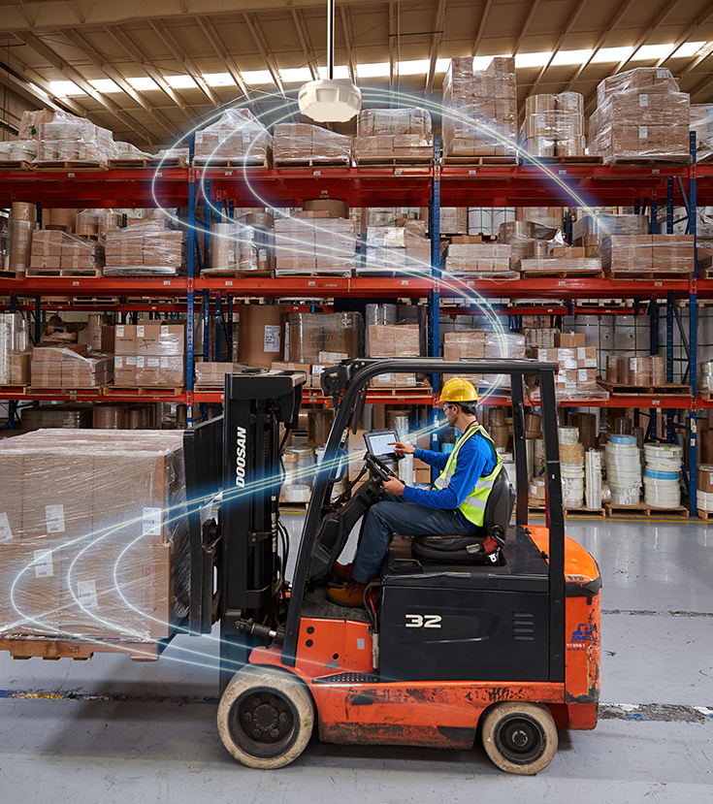
From Data Capture To Data-driven Decisions
By 2025, 82% of warehouse operators and IT leaders plan on investing in software for automating analytics and decision making
Software-as-a-Service Technology Implementation
Device Data Management
Machine Learning
Predictive Analytics
96%
96%
91%
39%
38%
36%
2022
By 2025
12
Notes:
As decision-makers begin add more devices to their fleets, the data they can gather and use from those devices will become invaluable to them, so having tools to capture, extract and manage that data will be important. Making this one of the software-as-a-service technologies that decision-makers will look to in the future.
As more data is captured automatically and use of location is more prevalent, software that can analyze that data as it is being captured will be necessary. Machine learning and predictive analytics will serve warehouse operators in automating more decision making, so front-line workers can focus their attention on execution.
Let’s take a look at some of these technologies for automated data capture.

Slide 13
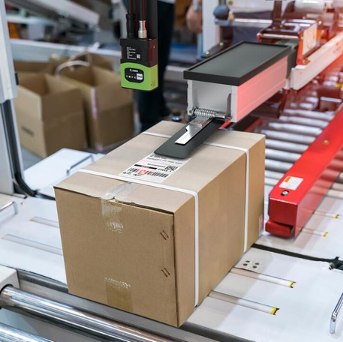
Speeding Up Data Capture To Solve Pressing Outbound Fulfillment Challenges
With respondents’ heightened concern for outbound packing, staging and loading operations, they have turned to sensor-based technologies to help automate data capture, information flow and decision-making. Some of the ways sensor-based technologies support these workflows include:
Fixed industrial scanning automates sortation workflows for outbound staging
Radio frequency identification (RFID) provides irrefutable proof of carton contents at shipping
Machine vision systems document outbound parcels by inspecting labels
Real-time location systems (RTLS) quickly locate material handling equipment, associates and inventory, even in motion
Mobile dimensioning software can capture accurate parcel dimensions to streamline operations with improved load planning and space utilization
Notes:
PRESENTER NOTE: These five technologies relate to the outbound operational challenges ranked by respondents as top operational challenges. Talk through how this automated data capture can help to free up labor to concentrate on more customer-centric tasks, yet provide the speed accuracy required to meet the demand of e-commerce.
Move to the next slide to show decision-makers’ implementation plans for these technologies.

Slide 14
Implementation Plans for Sensor Technologies
Each of these sensor inputs can be used with software applications powered by machine learning and artificial intelligence algorithms to provide more prescriptive guidance to front-line workers
Positive Radio Frequency Identification (Tags, Readers and Printers)
Indoor Location Services
Fixed Industrial Scanning
Machine Vision
Temperature Monitoring Sensors and Smart Labels
Mobile Dimensioning
Bluetooth Low Energy
33%
83%
92%
28%
82%
93%
30%
80%
92%
24%
80%
90%
28%
77%
90%
21%
78%
90%
24%
76%
86%
2022
By 2025
By 2027
Notes:
Respondents indicated plans to implement a variety of sensor-based technologies for automated data capture and real-time, location-aware services.
When planning implementation of these technologies, it is important that the specific challenge that needs to be solved is identified so the right technology can be deployed to solve the problem at hand.
Now, that we’ve set the scene for what is happening and beginning to look at how to address it through technology, let’s take it one more step further and talk about the role of automation and the best way to make that transition.

Slide 15
Equipping Workers With Mobility Devices And Printers
Decision-makers expect to use a variety of devices and form factors, which will help them better optimize the use of mobility
Handheld Mobile Computers with Built-in Barcode Scanners
Wearable Computers and Peripherals
Ultra-Rugged Scanners
83%
92%
84%
94%
80%
91%
43%
40%
29%
Decision-Makers See the Value of Connected Workers
Push-to-talk and messaging solutions
Vehicle-Mount Computer
Rugged Tablet
79%
91%
81%
92%
27%
25%
91%
80%
Industrial Barcode Label Printer
Desktop Barcode Label Printer
Mobile Barcode Label Printer
25%
81%
92%
84%
94%
83%
94%
32%
34%
32%
2022
By 2025
By 2027
Notes:
Decision-makers expect to use a variety of devices and form factors, which will help them better optimize the use of mobility. Wearables see increased implementation, while rugged tablets see the most dramatic increase over the next three years. Greater implementation of mobile barcode label printers will bring efficiencies to workflows.
As operations deploy automation throughout their facilities and depend on mobile robotics for autonomous material movement, front-line workers will utilize their devices not only for data capture and retrieval, but also to interact and collaborate with mobile robots

Slide 16
Lightening The Workload For Front-line Workers
Associate perspectives on reducing stress and physical requirements
As warehouse operators reimagine their operations, they are looking for options to use space more efficiently and improve front-line workers’ productivity.
Agree AMRs would make warehouse jobs less stressful for them and their colleagues.
81%
Associates’ Top Benefits of Working with Autonomous Mobile Robots (AMRs)*
83%
83%
Increases productivity
Reduces travel time and walking
Agree walking fewer miles would make their job more enjoyable, even if they had to pick more items.
78%
73%
Improves accuracy
*Associates have experience using/working with autonomous mobile robots.
Notes:
As warehouse operators reimagine their operations, they are looking for options to use space more efficiently and improve front-line workers’ productivity. Our survey asked associates with experience with autonomous mobile robots about their personal perceptions and experience with autonomous mobile robots. Those who work alongside AMRs today confirm they have helped increase productivity and reduce walking/travel time (83%) and reduce errors (73%).
Overall, the majority of associates, whether they worked with AMRs or not, agree AMRs would make warehouse jobs less stressful for them and their colleagues and say walking fewer miles would make their job more enjoyable, even if they had to pick more items.
It is encouraging to see both perspectives—with such high agreement on the value automation can provide.

Slide 17
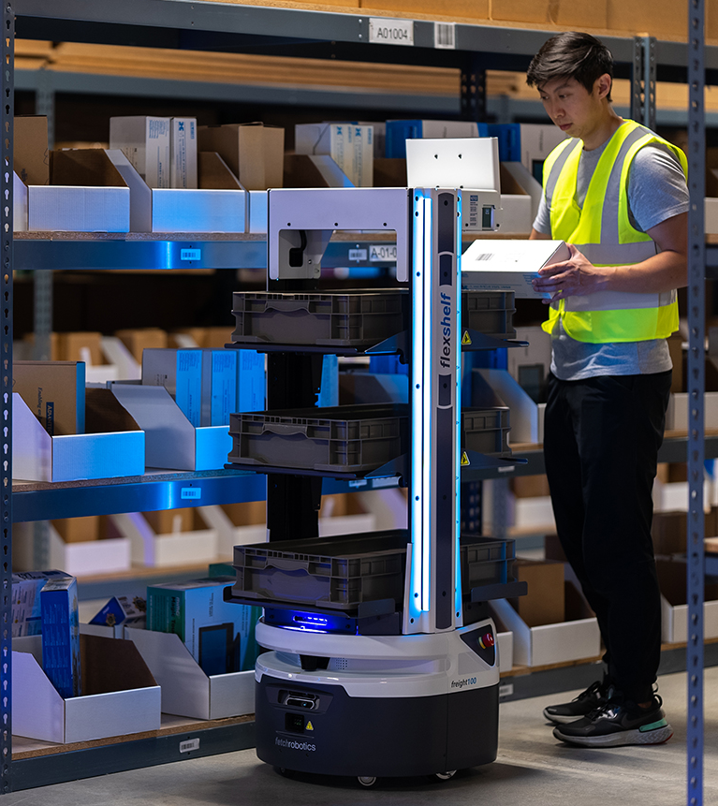
Current and Anticipated AMR Implementation Plans
As operators grapple with challenges around order fulfillment processing time, picking efficiency, order accuracy and outbound shipping operations, they are also gravitating to automation solutions that will directly address these challenges.
Person-to-Goods
Worker picks in warehouse aisles, guided by AMR
Goods-to-Person
Goods brought to worker at a pick station by AMR
93%
89%
62%
28%
55%
34%
Decision-Makers Overall Deployment Plans for Autonomous Mobile Robots
Materials Movement
Individual items, cartons, totes or pallets moved by AMR alongside workers and material-handling equipment
Materials Movement and Sortation
Individual items or cartons moved by AMR using special logic and form-factor enhancements to allow for sorting
90%
90%
90%
27%
53%
25%
53%
23%
Today
By 2027
2022
By 2025
By 2027
17
Notes:
As operators grapple with challenges around order fulfillment processing time, picking efficiency, order accuracy and outbound shipping operations, they are also gravitating to automation solutions that will directly address these challenges. For example, when workers can utilize autonomous mobile robots (AMRs) to help guide what and where to pick—as well as save time transporting goods to, from and between pick zones—they can increase their productivity and accuracy.
AMRs that work collaboratively in the aisles with workers are used by a higher percentage of decision-makers and will be within five years.
Today, 27% of warehouse operators have already deployed some form of autonomous mobile robots (AMR) today. Within five years, that number is expected to grow to 90%.

Slide 18
North America and Europe
NORTH AMERICA
EUROPE
Eighty-six percent of North American decision-makers say the pandemic has prompted them to evolve and modernize more quickly, the most of any region
Within three years, 81% of decision-makers plan to implement person-to-goods AMRs to collaborate and guide workers in order-picking workflows
Fifty-eight percent of decision-makers say the time to fill open positions is too long, making this the top challenge they need to address when it comes to labor initiatives. This is higher than all other regions and 7 pp higher than the global response
Eighty-five percent of associates say they are more likely to work for an employer that provides more modern devices to use for tasks, 4 pp higher than the global response
In five years, 83% of decision-makers in Europe say they will use mobility in their operations, with 47% also planning use of sensors for real-time visibility that will allow for automating tasks or decision-making
Notes:
A few of the regional perspectives include:
For North America, decision-makers have recognized the pandemic as a catalyst for change with a higher percentage of respondents saying that it prompted them to modernize and evolve their operations mor quickly. As a modernization effort, 81% of decision-makers plan to implement person-to-goods AMRs to collaborate and guide workers in order-picking workflows. This will hopefully help to fill labor gaps as they try to fill open positions that almost six in 10 say are open for too long.
In Europe, technology matters to associates. Eighty-five percent of associates said they would prefer to work for an employer with modern devices. The good news is, the majority of employers plan to use mobility in their operations and almost half will additionally deploy sensor technology for more real-time visibility as well as a competitive advantage.

Slide 19
Latin America and Asia-Pacific
LATIN AMERICA
Decision-makers expect the highest growth in both number (+44% more facilities) and size (+31% more square footage) of warehouse facilities in the next five years
Ninety-six percent of associates believe implementing warehouse technologies such as robotics and devices would help attract and retain workers, the highest of any region
Today, more decision-makers are implementing innovative wearable computers and peripheral devices than any other region (47%). This lead is projected to continue, with 98% expecting to implement these technologies within five years
ASIA-PACIFIC (APAC)
Nine in 10 decision-makers agree machine vision and/or fixed industrial scanning technology in key areas would save time and eliminate errors. Yet, only one-quarter say they are currently using or implementing these technologies
Decision-makers and associates differ in their assessment of the biggest challenge impacting their organization. Seventy-eight percent of associates rank fulfilling higher order volumes from increased e-commerce activity as the biggest challenge, while 74% of decision-makers feel predicting inventory availability and confirming inventory accuracy are most challenging
Notes:
As for Latin America, we see growth in the number and size of warehouse facilities over the next five years. As talked about earlier in the report, this gives decision-makers the opportunity to connect innovation as they are building out their new facilities. This in turn provide a competitive advantage as they begin to staff these new facilities. As 96% of associates believe implementing warehouse technologies such as robotics and devices will help attract and retain workers, this percentage is the highest of any region. To speak to device usage today, a higher percentage of LATAM decision-makers indicated use of wearable computers and peripherals and will continue in implementation in the next five years.
In the Asia-Pacific (APAC) region, decision-makers see the value of technology such as fixed industrial scanning and machine vision for automated data capture, but to-date only one-quarter have implemented these technologies. The good news is that within five years, 95% of APAC decision-makers say they will implement fixed industrial scanning and 92% are planning to implement machine vision systems. Higher order volumes are challenging associates and predicting inventory availability and confirming accuracy are most challenging to decision-makers. For both associates and decision-makers alike, the implementation of these systems will be beneficial to help speed up workflows and increase accuracy.

Slide 20
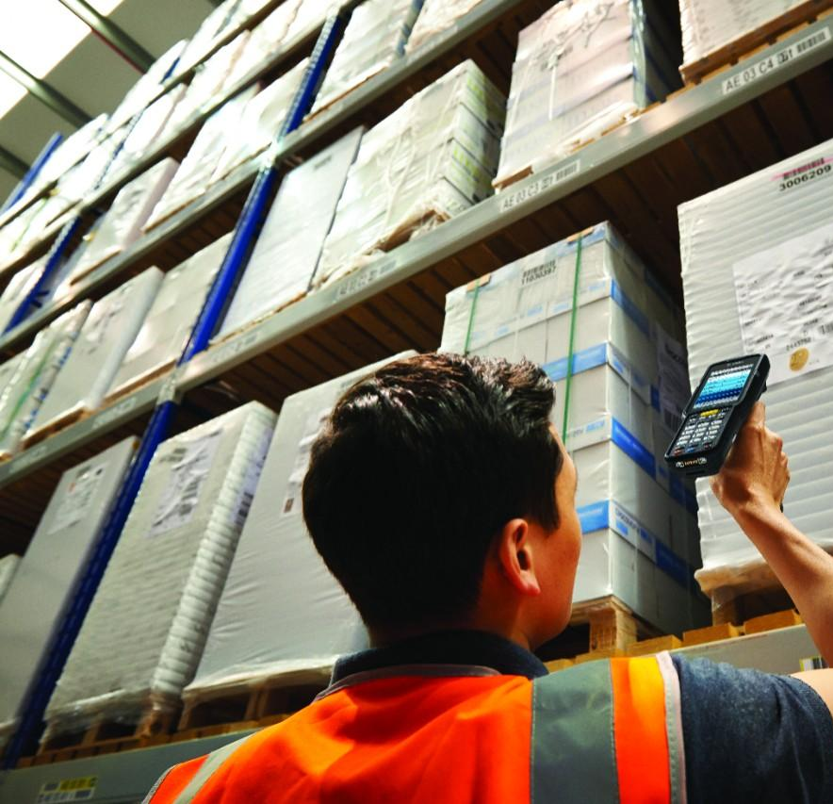
Key Takeaways
Market Pressures Become Catalyst for Positive Changes
Decision-makers agree they must implement new technologies to be competitive in today’s on-demand economy, and they are accelerating timelines and increasing funding
Front-line workers say positive workplace changes are happening even amid labor shortages. They report improved working conditions and new technology to make their jobs easier, increased wages and bonuses, and more flexible work shifts due to new technologies
Notes:
Summarize the on-screen bullets

Slide 21
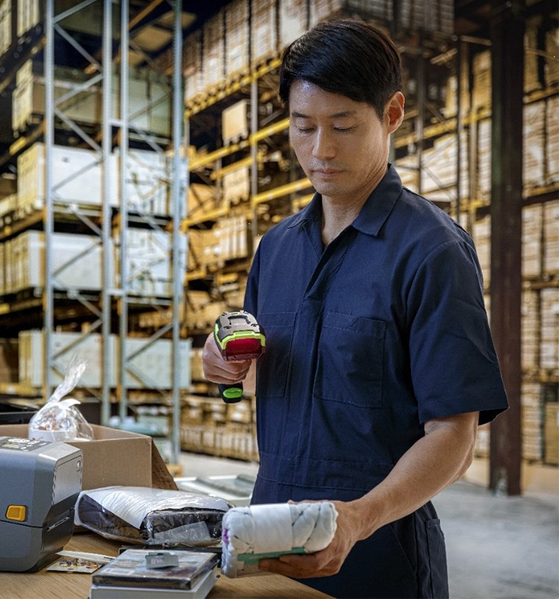
Key Takeaways
Top Warehouse Challenges
Shipping volumes have increased more than 20% on average for both business-to-business and business-to-consumer orders since 2019
Increased e-commerce activity is challenging decision-makers with unpredictable customer demands, faster delivery times and the need for greater inventory accuracy
Operationally, returns management and several outbound fulfillment-related operations are challenging decision-makers
Notes:
Summarize the on-screen bullets

Slide 22
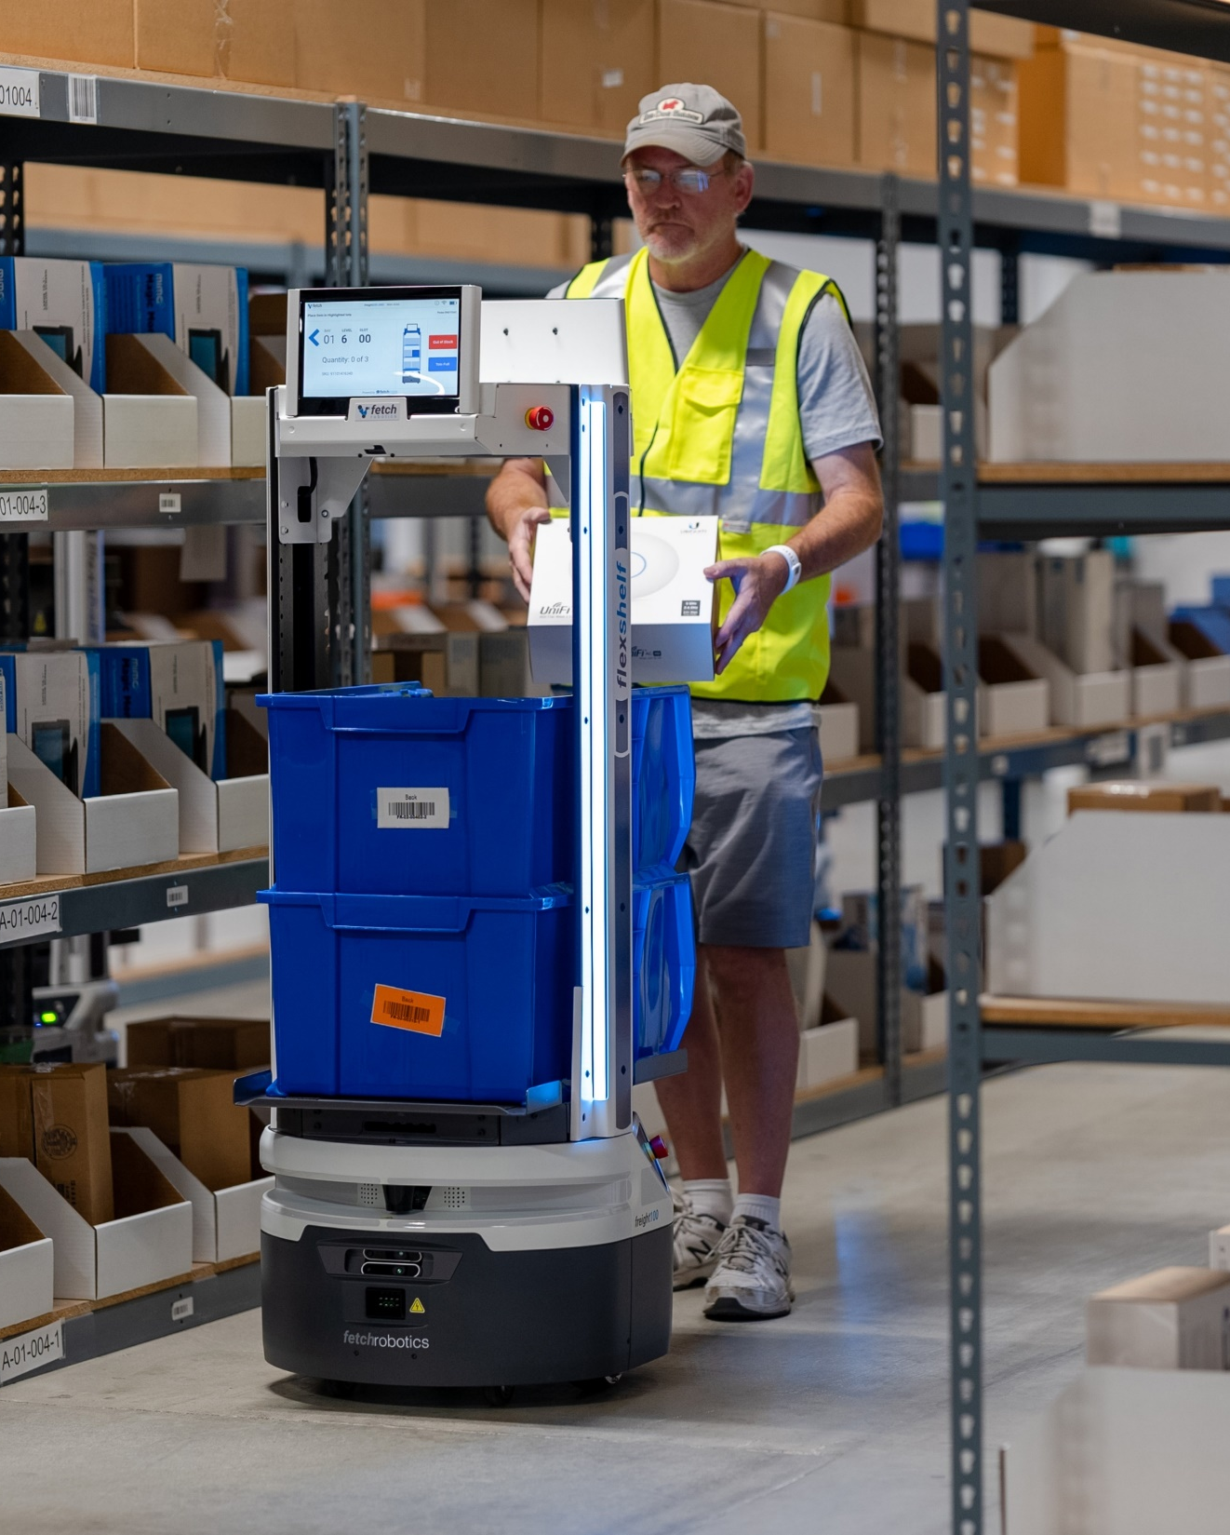
Key Takeaways
Five-Year Technology Outlook for Warehouse Operations
Reducing unnecessary tasks performed by front-line workers is a priority. There is concern business objectives won’t be met unless more technology investments are made to improve operations
With labor optimization as an initiative for decision-makers, augmenting workers will not only be with mobile devices, but also collaboration with automation solutions to help ease the workload within five years. Some also plan partial or full facility automation. Only 5% will continue to use paper-based or fixed workstations.
Almost six in 10 are expected to be utilizing mobility with some level of automated data capture, location solution, or predictive and adaptive data analytics, with more emphasis on automating decision-making and constantly predicting and adapting operations in real time
Notes:
Reducing unnecessary tasks performed by front-line workers is a priority for decision-makers and workers themselves. Both are concerned they will not meet their business objectives unless more technology investments are made to improve operations.
In the next five years, focusing on augmenting workers with devices will continue to be a priority for decisions, but also the data shows automation solutions that workers can collaborate with will make an appearance in warehouse operations to help ease workloads. More decision makers will opt for adding partial automation where they will need little to no worker interaction and some will even move towards full facility automation. Within five years, only 5% will continue to use paper-based or fixed workstations.
The use of real-time visibility and more automated data capture along with an augmented workforce will be embraced by almost six in 10 decision makers. This will allow for more automated decision-making and for a smaller percentage, it can mean constant predicting and adapting of their operations in real time.

